Slide 1
RECITATION 3: regression & Time series
15.774/780 (Fall 2021)

Slide 2
Announcements
HW1 due today at 5pm
HW2 posted and due next Friday 10/1 at 5pm
Start thinking about simulation & project teams
We’ll send an email next week about matching people
Notes:
Write formulas on the board before class

Slide 3
Agenda
Regression recap
Time series models
Autoregressive AR(q)
Moving Average MA(q)
ARMA models
SARIMA models
Notes:
Write formulas on the board before class

Slide 4
In my Ivory Tower…
We’ve seen two types of statistical models…
Explanatory explain what causes variation in an outcome
Time series project how sequence will evolve in the future
Steps for building a statistical model:
Hypothesize a model of the world (parameters & assumptions)
Find algorithm to fit parameters
Check assumptions and evaluate model
Use model to make predictions
Understanding gives intuition of why model is/isn’t good.
Notes:
Write formulas on the board before class

Slide 5
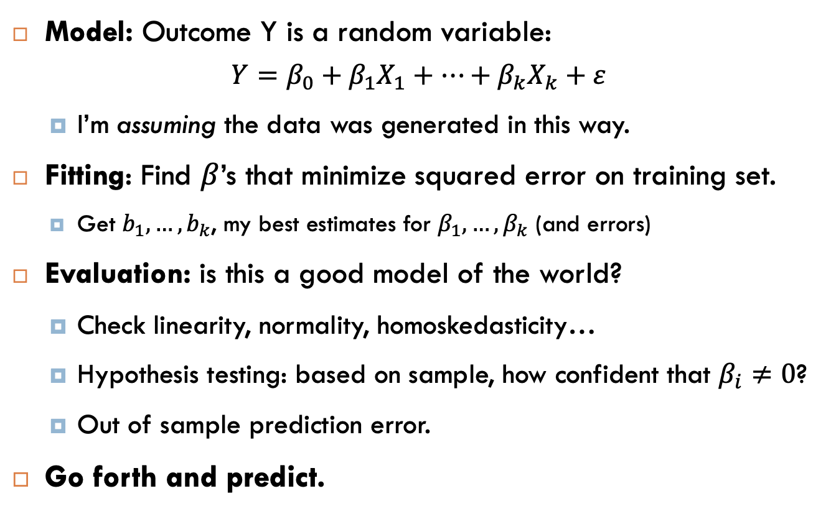
Regression
Model: Outcome Y is a random variable:
$$Y=β_{0}+β_{1}X_{1}+…+β_{k}X_{k}+ε$$
I’m assuming the data was generated in this way.
Fitting: Find $β$’s that minimize squared error on training set.
Get $b_{1}, …,b_{k}$, my best estimates for $β_{1},…,β_{k}$ (and errors)
Evaluation: is this a good model of the world?
Check linearity, normality, homoskedasticity…
Hypothesis testing: based on sample, how confident that $β_{i}≠0$?
Out of sample prediction error.
Go forth and predict.
Normal
Notes:
Write formulas on the board before class

Slide 6
Time series
Guiding principles:
Previous times are predictive of the future
More recent observations are more useful than older ones
Models might also want to model:
A global trend (may be linear or not)
Repetitive seasonal patterns
Notes:
Write formulas on the board before class

Slide 7
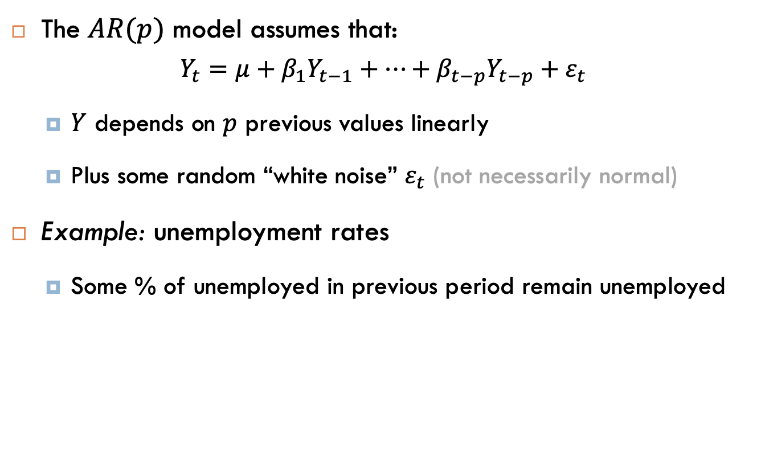
Autoregressive models
The $AR(p)$ model assumes that:
$$Y_{t}=μ+β_{1}Y_{t−1}+…+β_{t−p}Y_{t−p}+ε_{t}$$
$Y$ depends on $p$ previous values linearly
Plus some random “white noise” $ε_{t}$ (not necessarily normal)
Example: unemployment rates
Some % of unemployed in previous period remain unemployed
Notes:
Write formulas on the board before class

Slide 8
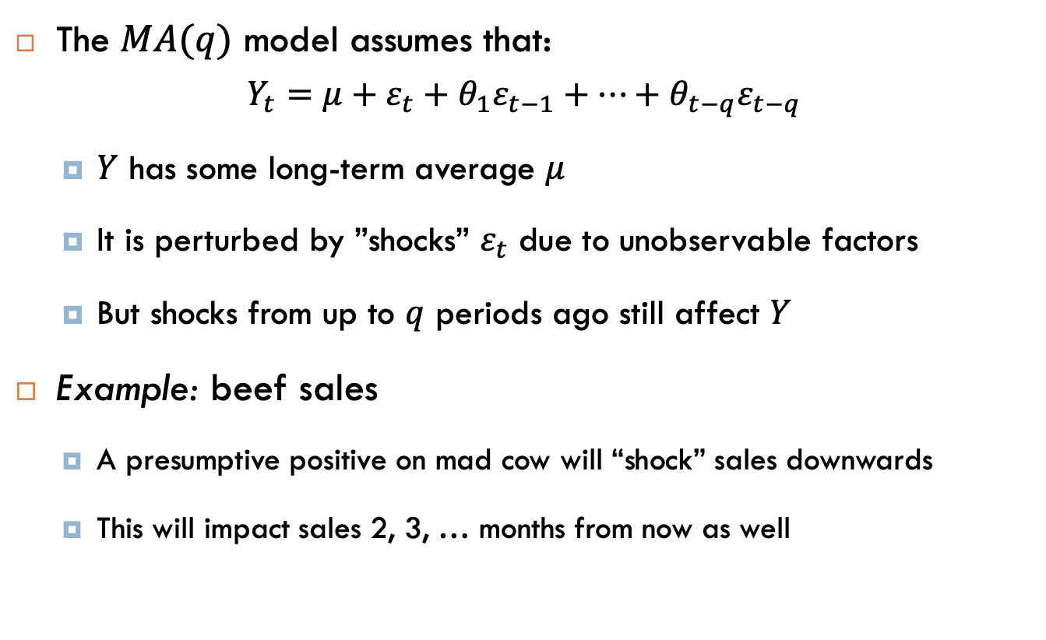
Moving average model
The $MA(q)$ model assumes that:
$$Y_{t}=μ+ε_{t}+θ_{1}ε_{t−1}+…+θ_{t−q}ε_{t−q}$$
$Y$ has some long-term average $μ$
It is perturbed by ”shocks” $ε_{t}$ due to unobservable factors
But shocks from up to $q$ periods ago still affect $Y$
Example: beef sales
A presumptive positive on mad cow will “shock” sales downwards
This will impact sales 2, 3, … months from now as well
Notes:
Write formulas on the board before class

Slide 9

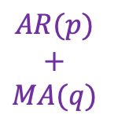
Why not both?
The $ARMA(p,q)$ model assumes that:
$$Y_{t}=μ+β_{1}Y_{t−1}+…+β_{t−p}Y_{t−p}+ε_{t}$$
$$+θ_{1}ε_{t−1}+…+θ_{t−q}ε_{t−q}$$
Linear relationship with previous values.
AND shocks persist.
$$AR(p)$$
$$+$$
$$MA(q)$$
But what about trend and seasonality?
Notes:
Write formulas on the board before class

Slide 10
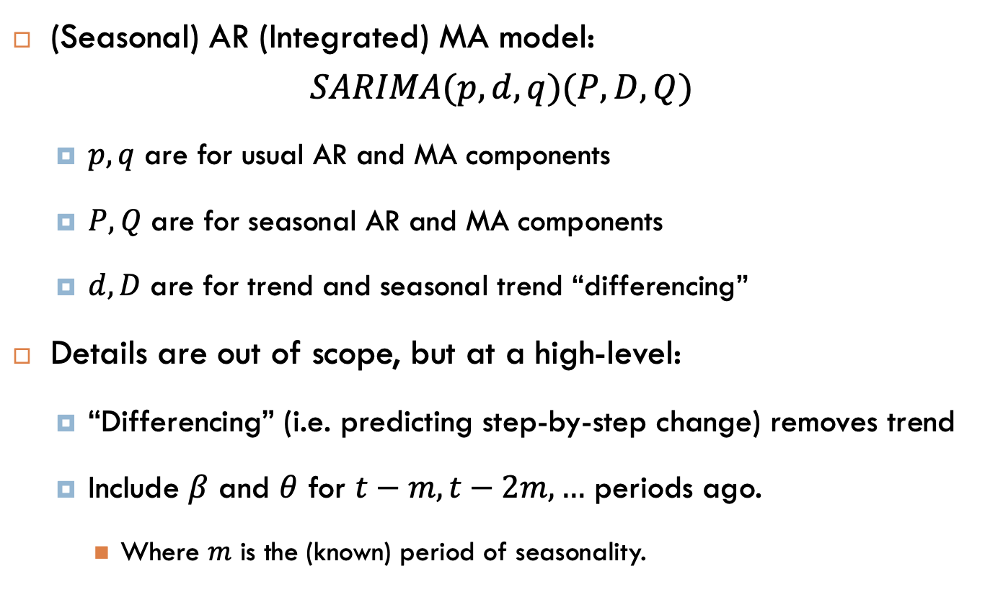
(S)ARIMA model:
(Seasonal) AR (Integrated) MA model:
$$SARIMA(p,d,q)(P,D,Q)$$
$p,q$ are for usual AR and MA components
$P,Q$ are for seasonal AR and MA components
$d, D$ are for trend and seasonal trend “differencing”
Details are out of scope, but at a high-level:
“Differencing” (i.e. predicting step-by-step change) removes trend
Include $β$ and $θ$ for $t−m, t−2m,…$ periods ago.
Where $m$ is the (known) period of seasonality.
Notes:
Write formulas on the board before class

